Slide 1
Javascript
Lecturer
Abdullah Yousaf

Slide 2
Table of Contents
Introduction
Usage
Output
Syntax
Operators
Data Types
If Else
Loops

Slide 3
Introduction
Most Popular Programming Language
JS frameworks i.e Node JS, ReactJS is highly in demand in industry
Used mainly for front end validation and more powerful than html and css
Other usage includes HTML5 Gaming, Animations , API calling e.t.c

Slide 4
How to use
Create any html file
Open in text editor
Use <script> </script> tag to write JS code (just like you use <style> tag to write css in between)
Note: Every statement (Apart from few) must ends with “;” in javascript similar to c++ otherwise your js code will not run properly.

Slide 5
How to use
1) In between script tag write document.write(“This is my first javascript program”)
<html>
<body>
<script>
document.write("This is my first Javascript
program");
Document.write is builtin javascript function which acts similar to cout in c++. It prints the data in html
</script>
</body>
</html>

Slide 6
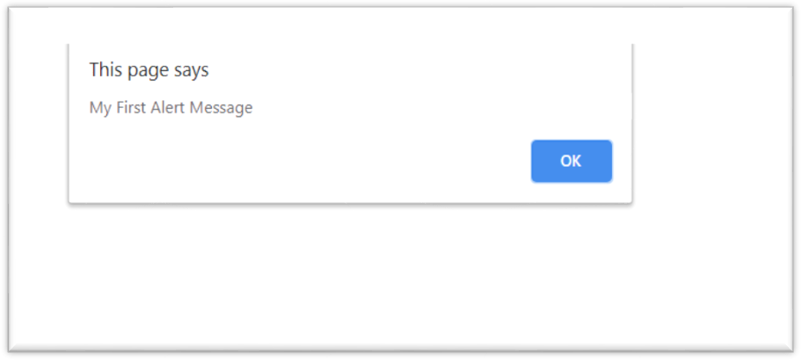
Output using alert()
<html>
<body>
<script>
alert("Hello! I am an alert box!");
</script>
</body>
</html>
alert() is builtin javascript function which outputs the data in form of popup message. It is commonly used for alert messages or for debug purposes

Slide 7
Output using document.write()
Using document.write() after an HTML document is fully loaded, will delete all existing HTML:
It should only be used
for Testing
<html>
<body>
<p> hello </p>
</body>
<script>
document.write("This is my first Javascript program");
</script>
</html>

Slide 8
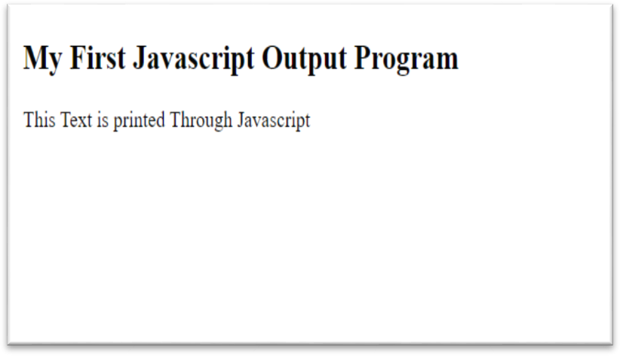
Output using document.getelementbyid().innerhtml
1) In between script tag write document.write(“This is my first javascript program”)
1)
In between script tag write document.write(“This is my first javascript program”)
<html>
<body>
<h2>My First Javascript Output Program</h2>
<p id="demo"></p>
<script> document.getElementById("demo").innerHTML = "This Text is printed Through Javascript";
</script>
</body>
</html>
Document.getelementbyid(id).InnerHTM L is function which paste the html inside the the tag you specified e.g in this example we specified the element with id “demo” which is paragraph so this function will paste the text inside paragraph. You can even put tags inside
e.g <b> </b> tag. In short whatever you write after = will be pasted inside the “demo” tag (in our case)

Slide 9

Basic Syntax
Every statement other then if,else,while,switch will end with semicolon “;”
You don’t mention data types with variables i.e if you want to declare a variable x the simple way will be var x=0;
<!DOCTYPE html>
<html>
<body>
<h2>JavaScript Syntax</h2>
<script>
var x,y,z;
x=0;
y=12;
z=15;
var x, y, z;
x = 5; y = 6;
z = x + y; Values
// Declaration
// Assign Values
// Compute
var result=x+y*z;
document.write("Result of X+Y*Z:");
document.write(result);
</script>
</body>
</html>

Slide 10
Operators
var x = 5; var y = 2; var z = x + y;
var z = x * y;
The + operator can also be used to add (concatenate) strings.
var txt1 = "John";
var txt2 = "Doe";
var txt3 = txt1 + " " + txt2; //output will be John Doe
// assign the value 5 to x
// assign the value 2 to y
// assign the value 7 to z (5 + 2)
// Multiply x and y and assign value to z

Slide 11
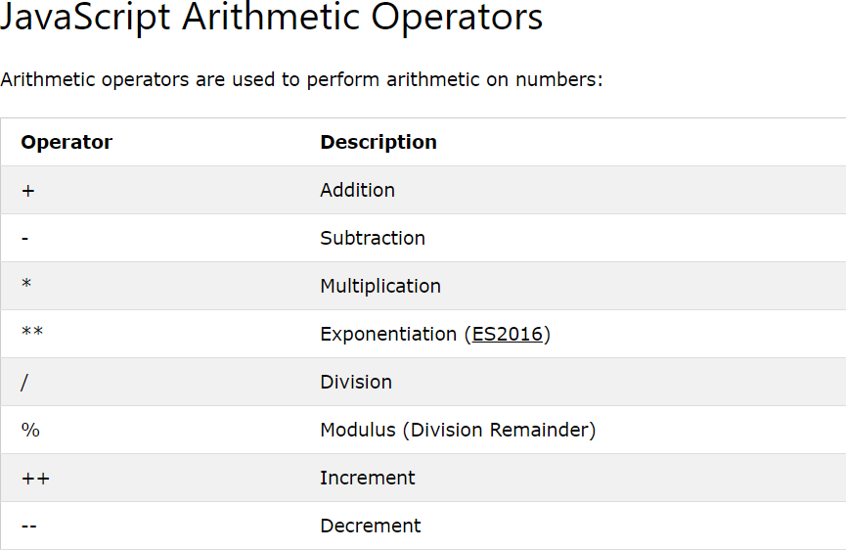
Operators

Slide 12
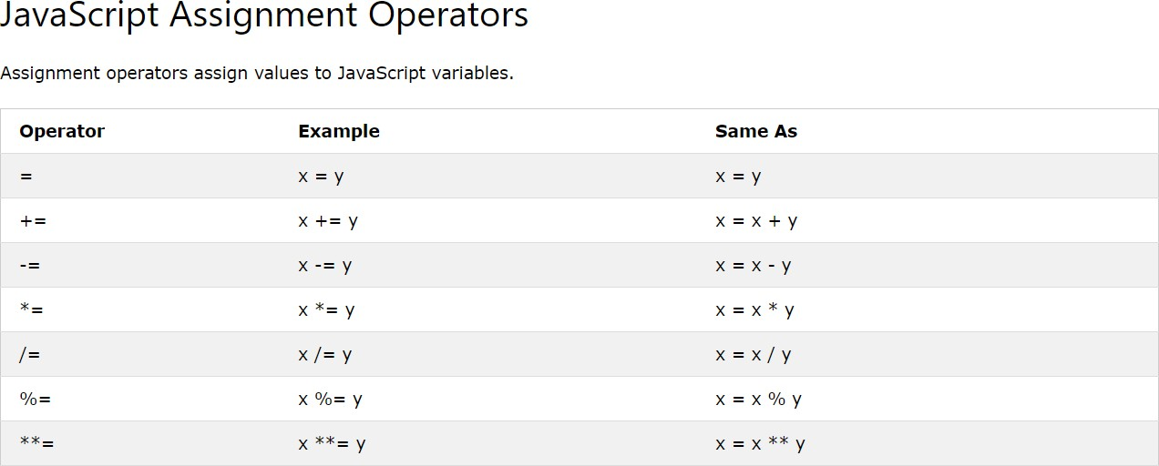
Operators

Slide 13
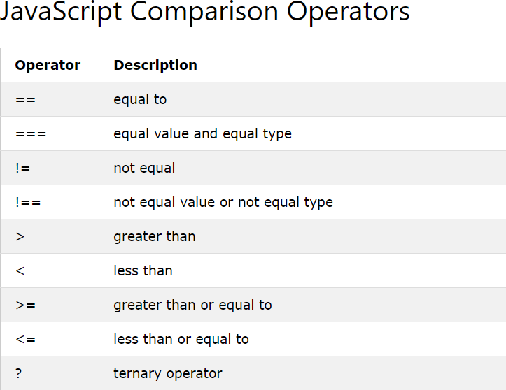
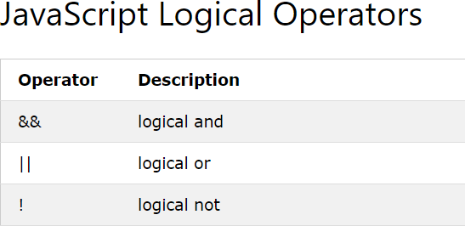
Operators

Slide 14
Data Types
By default JavaScript uses implicit data types
E.g in c++ you explicitly write data type with variables
i.e int c=0; string str=“this is string”; float flt=10.9;
But in JavaScript you don’t explicitly write data types like in c++ instead you just write var then variable name i.e var x=0; var str=“this is string”; var flt=10.9;
JavaScript automatically or in other others implicitly detects what value is inside any variable (either its integer,float,string) and deal it accordingly

Slide 15
Data Types
JavaScript variables can hold many data types: numbers, strings, objects and more:
JavaScript is dynamic, that means same variables can hold different data types.
Recall c++ if you have ever defined int x=0; you can never put string or integer value in x variable. It will always be integer but in javaScript you can change the value later
var x; x = 5;
x = "John";
// Now x is undefined
// Now x is a Number
// Now x is a String

Slide 16
Data Types
var x = 100 + “Riphah"; Does this makes any sense to add 100 to Riphah (An integer adding to a string)?
Instead javaScript will treat same thing as var x
= “100" + “Riphah"; so output will be 100Riphah (The 100 will also treated as string by javascript and will be concatenated with Riphah)
var x = 100 + 4 + “Riphah"; // What will happen with this statement?

Slide 17
Data Types
Output will be 104Riphah . But how?
JavaScript reads the statement from left to right so when it will start reading statement it will first read 100 which is integer and then when it will reach 4 it will immediately add 100+4=104 but when it will reach Riphah it will automatically convert 104 into string and concatenate it with Riphah
var x=“Riphah”+100+4; // What will happen now?

Slide 18
Data Types
Riphah1004
Again since we talked about javaScript read the statement from left to right. It will first read a string so immediately every thing after than will be treated as string and will be concatenated with Riphah
var x=“Riphah”+100+4;

Slide 19

Data Types (Strings)
You can use quotes inside a string, as long as they don't match the quotes surrounding the string
var answer1 = "It's alright";
var answer2 = "He is called 'Johnny'"; var answer3 = 'He is called "Johnny"';

Slide 20
Arrays
var cars = ["Saab", "Volvo", "BMW"];
If you want to get anything at specific index you can use cars[0];cars[1];cars[2];
What will you get if you write cars[1];?

Slide 21
If condition
Syntax
if (condition) {
// block of code to be executed if the condition is true
}
<script> var x=10;
if (x < 18) {
document.write("number is less than 18");
}
</script>

Slide 22
If else condition
Syntax
if (condition) {
// block of code to be executed if the condition is true
}
else{
// block of code to be executed if the condition is false
}
<script> var x=10; if (x < 18) {
document.write("number is less than 18");
}
else
{
document.write("number is greater than or equal 18");
}
</script>

Slide 23
Mutiple If else condition
Syntax
if (condition1) {
// block of code to be executed if condition1 is true
} else if (condition2) {
// block of code to be executed if the condition1 is false and condition2 is true
} else {
// block of code to be executed if the condition1 is false and condition2 is false
}

Slide 24
Example Multiple if else
<script>
var greeting;
var time = new Date().getHours(); //builtin javascript function that gets current
hours of time;
if (time < 10) {
greeting = "Good morning";
} else if (time < 20) {
greeting = "Good day";
} else {
greeting = "Good evening";
}
document.write(greeting);
</script>

